Slide 1


EXECUTIVE HEADTEACHER
THE SAINTS FEDERATION | APRIL 2026

Slide 2
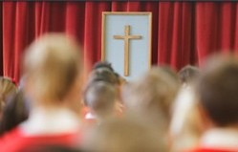

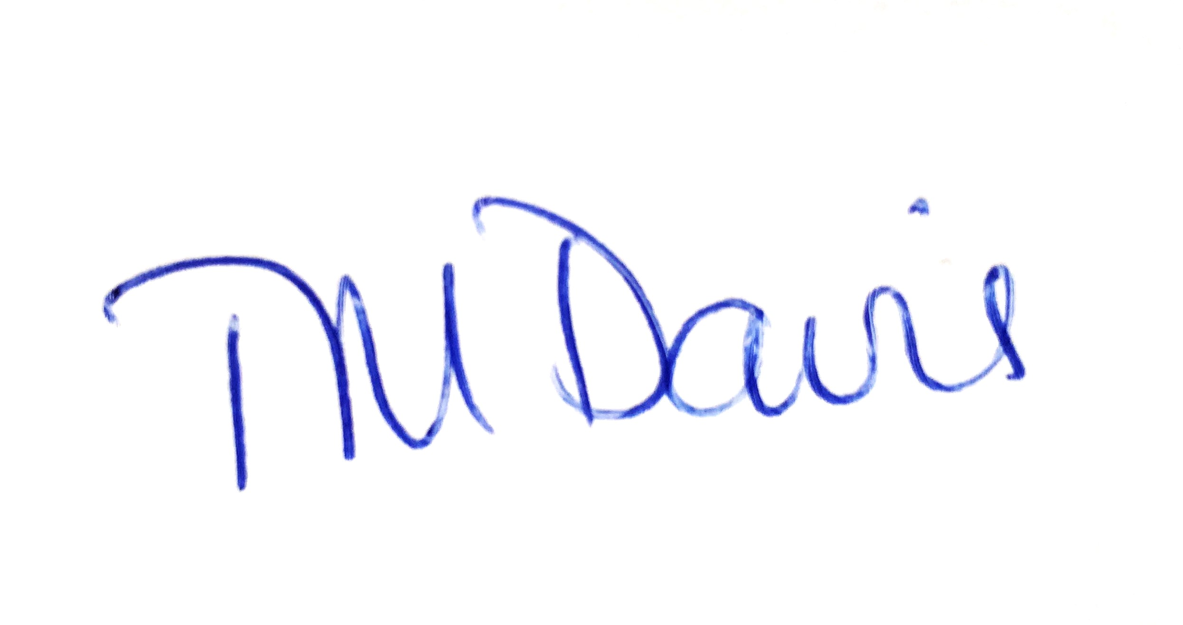
RECRUITMENT PACK
Dear Applicant,
On behalf of the Governors, I would like to thank you for your interest in the role of Executive Headteacher of The Saints Federation. This role presents an exciting opportunity for an inspiring leader to continue and develop the excellent work already happening in our schools, as well as growing the federation and ensuring the sustainability of our schools for the future.
Everything we do at The Saints Federation is underpinned by our clear Christian values. Our new Executive Headteacher will join a happy and secure organisation, where everyone is committed to the provision of educational excellence in a supportive, caring and safe learning environment, where everyone – pupils and staff - can flourish.
Under the leadership of the current Executive Headteacher, Miss Cathryn Mann, St Andrew’s and St Paul’s CE Primary Schools (both in the London Borough of Enfield) have been successfully working together since September 2022. Initially this was in a partnership arrangement, but since September 2025 as The Saints Federation.
The Federation is supported by the London Diocesan Board for Schools (LDBS) and our vision – Grow Together – reflects the LDBS vision for its schools to be places that are both deeply Christian and committed to serving the common good with Jesus’ invitation to ‘life in all its fullness’ at their heart (John 10:10).
EXECUTIVE HEADTEACHER
Since 1 December 2025, we are also in a formal partnership arrangement with St Paul’s CE Primary School, Friern Barnet, a one-form entry school in the London Borough of Barnet.
All three schools were judged as Good in their most recent Ofsted inspections
Each school has its own unique character and community, but all three are united by a strong Christian ethos and each school has strong links to their respective Parish Churches – St Andrew’s Church, Enfield Town, St Paul’s Church, Winchmore Hill and St Paul’s Church, New Southgate.
Following the announcement of Miss Mann’s planned retirement at the end of 2026, we are now looking for an experienced, strong and committed leader, who will build on her excellent work and continue to promote our values both within and outside the school community, whilst ensuring a high quality of education for all pupils.
You are encouraged to come and visit us, so that you can experience the caring, supportive atmosphere in our schools for yourself.
I wish you every success in your application and look forward to welcoming you to our Federation
Best wishes
Theresa Davis
Chair of Governors
Welcome from the Chair of Governors

Slide 3
APPLICANT PACK
EXECUTIVE HEADTEACHER
Introducing The Saints Federation
TIMELINE
A recently established, growing Church of England primary federation in North London
Autumn 2022
Two successful Enfield CE primary schools enter partnership under a shared Executive Headteacher
Two double-form entry CE primary schools in Enfield are
federated
within The Saints Federation.
The Federation is in
partnership
with a third one-form entry CE primary in Friern Barnet.
The schools each have their own well-established, and thriving
distinct ethos,
but all schools are committed to the Federation’s guiding aim:
to provide opportunities for growth,
so that our community flourishes.
Autumn 2024
Based on the partnership’s success, the schools’ governors explore creation of a new federation.
The Federation is
outward looking
Our schools participate in local school partnerships, such as the Enfield Town Schools’ Partnership, and are active in their local communities…
Summer 2025
The partner schools formally consult on the creation of a federation.
… and all three schools maintain
strong parish links
with their respective clergy and churches
Autumn 2025
The Saints Federation formally established on 1 September. Enters partnership with St Paul’s CE Primary School, Friern Barnet from 1 December 2025.

Slide 4
RECRUITMENT PACK
EXECUTIVE HEADTEACHER
Executive Headteacher
The Saints Federation
Head of School
St Andrew’s CE Primary School
Head of School
St Paul’s CE Primary School N21
Head of School
St Paul’s CE Primary School N11
Teaching Staff
Site Manager
Office Staff
Office Staff
Teaching staff
Site Manager
Office Staff
Site Manager
Teaching Staff
Federation
Staffing Structure 2025-2026
Roles and responsibilities may differ across Federation schools
In Partnership
Finance
Office Manager
Class Teachers
Class Based LSA
Senior Dinner Supervisors
Relief Caretaker
Cleaning Staff
Kitchen
Staff
Dinner
Supervisors

Slide 5



RECRUITMENT PACK
Across the Federation and Partnership:
OUR SCHOOLS IN NUMBERS
 | St Andrew’s | St Paul’s N21
Pupils on roll | 390 | 416
SEND | 13% | 8%
EHCP | 3% | 2%
Pupil Premium etc | 15% | 2%
EAL | 22% | 3%
St Paul’s N11
182
20%
9%
24%
77%

Slide 6
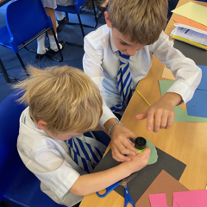
JOB DETAILS

Slide 7

RECRUITMENT PACK
EXECUTIVE HEADTEACHER
We are looking for:
What we can offer:
An experienced, inspirational primary school leader, who:
will provide strategic leadership across the Federation and our partner school to set direction and vision for several schools, setting high standards for teaching and learning and resulting in excellent outcomes for pupils;
will support and develop other Federation school leaders, empowering them to lead with confidence;
will manage staff development and curriculum oversight, to ensure that there is professional growth for staff and that the curriculum is effectively implemented to achieve the Federation’s educational goals.
is an effective communicator, who will build trust and foster partnerships with parents, governors and the community to promote excellence and ongoing school improvement;
will support and enhance the Federation’s Christian ethos and is excited by the prospect of taking the Federation forward
The opportunity to lead highly motivated and ambitious teams, dedicated to enabling all pupils to flourish;
Schools with a strong ethos of inclusion and opportunities for all;
A supportive community, eager to help the Federation develop and grow;
Governors committed to your professional development;
Governors with a genuine concern for the wellbeing of school leaders, who understand the challenges currently facing schools and who are determined to support school leaders in meeting those challenges;
The opportunity to be part of our vision for the future of education in this part of London.

Slide 8
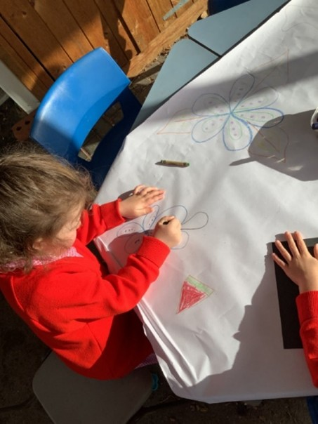
RECRUITMENT PACK
EXECUTIVE HEADTEACHER
Main purpose of Executive Headteacher role:
To provide strategic leadership across three London Diocesan Board for Schools (LDBS) primary schools (two in The Saints Federation and one in partnership), to support and promote the Christian vision and ethos of the Federation.
To secure robust governance, financial sustainability and high standards of safeguarding and compliance across all three schools.
To build leadership capacity at all levels and develop and support the Heads of School in leading their schools effectively, ensuring alignment with the Federation’s vision, values and educational strategy.
To ensure a broad, balanced, diverse and accessible curriculum in all Federation schools and to set and maintain ambitious expectations for all pupils, including those with special educational needs and disabilities.
To carry out the duties of this post in line with the remit outlined in the current School Teachers’ Pay and Conditions Document (STPCD).
Job
description:
EXECUTIVE
HEADTEACHER

Slide 9
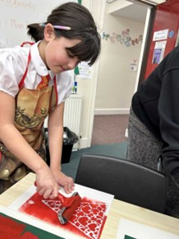
RECRUITMENT PACK
EXECUTIVE HEADTEACHER
Key Duties and Responsibilities
Strategic Leadership, Vision and Culture
To promote and embed our clear Christian vision and values, ensuring they are lived through curriculum design, behaviour and relationships, staff culture and decision-making across all schools;
To nurture and empower Heads of School and senior managers to lead with confidence;
To develop, implement and review the Federation’s strategic plan, ensuring that key objectives being met through individual school improvement plans.
To promote a culture of effective safeguarding across the Federation, to create communities where pupils are safe and valued, and their wellbeing is prioritised;
To expand the Federation securely, working with schools actively seeking to join to ensure cohesive long-term development and improvement;
To champion an educational environment that is ambitious for all pupils, including those with special educational needs or disabilities (SEND).
Job
description:
EXECUTIVE
HEADTEACHER

Slide 10
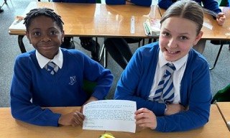
RECRUITMENT PACK
EXECUTIVE HEADTEACHER
Organisational Management
To lead financial planning and build budget management capacity across the Federation, to ensure financial stability and sustainability;
To work closely and effectively with the Governing Board, the LDBS and local authorities, to ensure that all schools are operating effectively and are complying with statutory duties and policies;
To facilitate collaboration and sharing of expertise and innovation throughout all levels within the Federation;
To support, challenge and develop Heads of School to maintain communities where pupils’ learning and wellbeing are central;
To build and maintain strong, collaborative professional relationships with the Federation community (including pupils, staff, parents and carers, local parishes and clergy), as well as other external agencies and stakeholders, to foster a collaborative approach to school improvement and to improve educational outcomes for all.
Job
description:
EXECUTIVE
HEADTEACHER

Slide 11
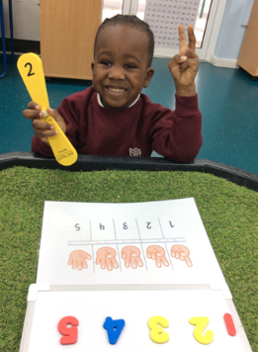
RECRUITMENT PACK
EXECUTIVE HEADTEACHER
Teaching and Learning
To ensure excellent academic progress and attainment at every stage, measured against pupils’ starting points.
To use schools’ data and intelligence and external benchmarks to identify priorities for intervention and improvement
To ensure a strong standard in Ofsted and SIAMS inspections.
To maintain ambitious expectations for all pupils and promote an inclusive environment enabling all pupils, including those with SEND, to access the curriculum and thrive
To ensure that children are thriving, love learning, achieve well, particularly in oracy, reading and numeracy, play cooperatively, and show kindness and consideration towards one another.
  Please note: This list of duties is illustrative of the general nature and level of responsibility of the role and is not a comprehensive list of all the tasks that the Executive Headteacher will need to undertake. This job description may be amended at any time in consultation with the postholder.
Job
description:
EXECUTIVE
HEADTEACHER

Slide 12
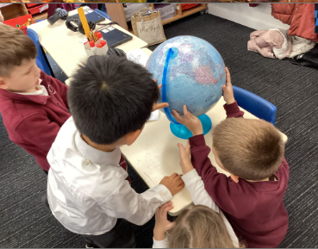
RECRUITMENT PACK
EXECUTIVE HEADTEACHER
Professional Expectations
To uphold the highest standards of behaviour, integrity, professional confidentiality and ethical leadership.
To engender a culture of continuous improvement for all, in terms of both professional learning and reflective practice;
To represent the Federation professionally and effectively in local and national forums, ensuring that the Federation’s reputation as a place of educational and pastoral excellence is maintained;
To ensure that children in the Federation’s schools are thriving, love learning, achieve well, particularly in oracy, reading and numeracy, play cooperatively, and show kindness and consideration towards one another.
  Please note: this list of duties is illustrative of the general nature and level of responsibility of the role. It is not a comprehensive list of all the tasks that the Executive Headteacher will need to undertake.
Job
description:
EXECUTIVE
HEADTEACHER

Slide 13
RECRUITMENT PACK
Person Specification
E/D: Essential or Desirable
A/I/R: Assessed at Application (A), Interview (I), Reference (R)
Person Specification
 | E/D | A/I/R
Educated to at least degree level | E | A
Qualified Teacher Status (QTS) | E | A
Evidence of engagement in significant professional development (eg NPQH or NPQEL) | E | A
Track record as a successful Primary Headteacher or Executive Headteacher | E | A/I/R
Aspirational leader, setting high expectations for all, but committed to ensuring the wellbeing of staff and pupils alike | E | I
A thorough understanding of the requirements of the National Curriculum | E | A/I
Proven track record of sustained school improvement | E | A/I/R
Effective delegator who empowers and develops others through direction and coaching | E | A/I
Proven track record of developing and mentoring school leaders | E | A/I/R
Outstanding communications skills , with the ability to engage effectively with different audiences | E | A/I
 | E/D | A/I/R
Strong analytical skills, and ability to use data to support improvement | E | A/I/R
High levels of emotional intelligence, integrity and professionalism | E | I/R
Up-to-date knowledge of safeguarding legislation and best practice | E | A/I
Understanding of school finance and budget planning framework | E | A/I/R
Proven experience of successful budget management | E | A/I/R
Recent experience as DSL/DDSL | D | A/I
Experience of developing an inclusive curriculum for all pupils, including those with SEND | D | A/I
Teaching experience across the Primary age range | D | A/R
Time spent teaching in more than one school, or educational setting | D | A
In-depth knowledge of Ofsted and SIAMS evaluation frameworks | D | A/I

Slide 14


RECRUITMENT PACK
EXECUTIVE HEADTEACHER
Salary:
Key Dates:
Further
information
Dependent on experience,
Leadership Scale: L22 – L28 £90,906 - £104,648
Contract type: Permanent
Hours: Full time
We would warmly welcome visits during the following times:
23 April – morning only
1 May – morning only
Closing date for applications:
Midday Wednesday 6 May 2026
Interviews and Assessment Tasks: Friday 15 May 2026
Start date: 1 January 2027
Please submit your completed application form via email to:
governors@st-andrews-enfield.enfield.sch.uk
How to Apply:
To request a visit, or for more
information, please contact:
Mrs Marie Andrews Tel: 0208 363 5003
Email: mandrews@st-Andrews-enfield.enfield.sch.uk
These visits may form part of the selection process.
Applications must be submitted using the application form provided. CVs will not be considered. In line with safer recruitment guidance, we normally request references after shortlisting and before interview. Please supply the official email addresses of your referees for us to contact.

Slide 15
APPLICANT PACK
EXECUTIVE HEADTEACHER
Introducing the LDBS
We have been serving and supporting schools since 1836
Our schools are distinctively Christian in ethos
Christian distinctiveness
should shape everything that happens in a Church school
We support schools to provide
high quality
Collective
Worship
We support
chaplaincy
in educational settings
There are
154
Church schools in the Diocese
of London:
Outcomes from the Statutory Inspection of Anglican and Methodist Schools (SIAMS) reflect the Christian distinctiveness of our schools: more of our schools are rated as
Excellent
than the national average.
135
primaries with 87 nursery classes.
4 all through, 19 secondary, and 2 schools for children with SEND
We support Churches and
schools to
work together
for mutual benefit
There are almost
300
LDBS appointed Foundation governors and trustees serving on the boards of Church schools across London
Our schools
include Voluntary Aided schools, Single and Multi-Academy Trusts and a Voluntary Controlled school
“I have come in order that you might have life – life in all its fullness.” John 10:10

Slide 16
APPLICANT PACK
EXECUTIVE HEADTEACHER
Introducing the LDBS
Our schools serve 55,000 young Londoners
LDBS provides:
Training, advice and resources
for school leaders to support school improvement
A comprehensive programme of
governor training
Many
community and Roman Catholic schools buy our school improvement and support services
More
than half
of pupils in our schools have an Asian, Black, Mixed or Other background. One quarter have a white British background
Our schools are
inclusive:
they have more primary children with a recognised special education need and/or Education Health Care Plan (ECHP) than the London and national averages
We run a SCITT (School Centred Initial Teacher Training which is rated
outstanding
by Ofsted
HR support
Data protection support
They are from the Christian faith, other faith and no faith backgrounds
Our schools transform futures:
Young people make more progress and attain
higher standards
in our secondary schools than the London and England averages
Primary children in our schools make
more progress in reading than the London and national averages
More primary
children
In our schools achieve the expected primary schools standards in reading, writing and maths than the London and national averages
Our schools serve
deprived communities:
there are more primary children registered for free school meals in our schools than the London and national averages

Slide 17
London Diocesan Board for Schools
www.ldbs.co.uk 020 7932 1100
London Diocesan Board for Schools is a Charitable Company Limited by Guarantee.
Company Registration No 198131. Charity Registration No 313000.
Registered Address: London Diocesan House, 36 Causton Street, London, SW1P 4AU

